Slide 1
Nuclear Magnetic Resonance (NMR)
Kangbo Hao
PHYS 211 A

Slide 2
Outline
Basic Principle of NMR
Techniques Used for NMR Spectroscopy
Recent Discovery with NMR Study

Slide 3
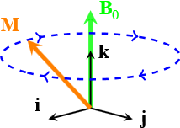
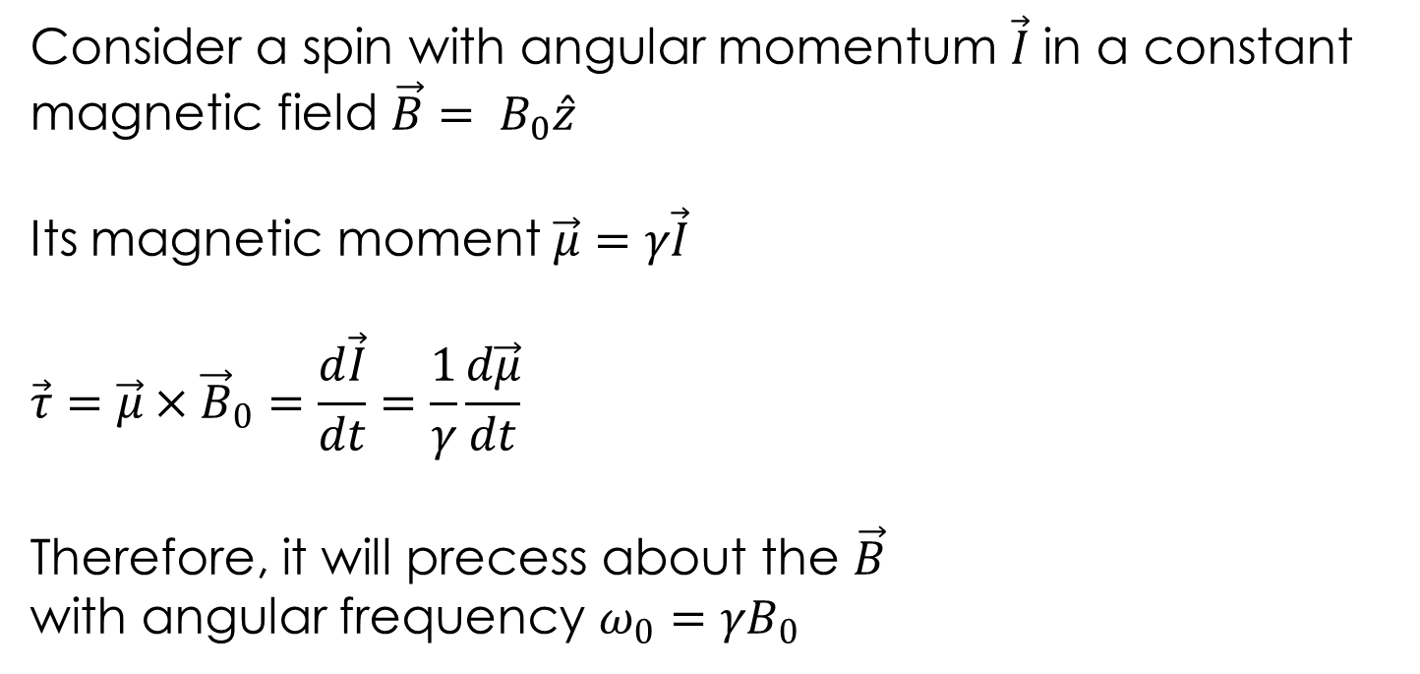
Basic Principle
Consider a spin with angular momentum $\vec{I}$ in a constant magnetic field $\vec{B}= B_{0}\hat{z}$
Its magnetic moment $\vec{μ}=γ\vec{I}$
$$\vec{τ}=\vec{μ}×{\vec{B}}_{0}=\frac{d\vec{I}}{dt}=\frac{1}{γ}\frac{d\vec{μ}}{dt}$$
Therefore, it will precess about the $\vec{B}$
with angular frequency $ω_{0}=γB_{0}$
Larmor Frequency

Slide 4
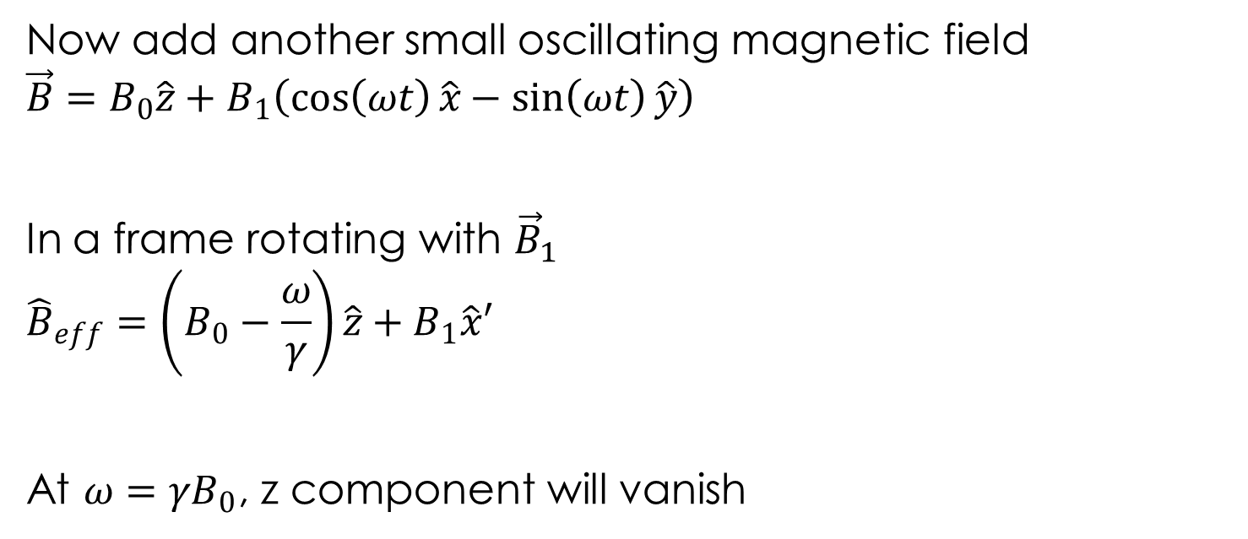
Now add another small oscillating magnetic field
$$\vec{B}=B_{0}\hat{z}+B_{1}\left(\cos\left(ωt\right)\hat{x}−\sin\left(ωt\right)\hat{y}\right)$$
In a frame rotating with ${\vec{B}}_{1}$
$${\hat{B}}_{eff}=\left(B_{0}−\frac{ω}{γ}\right)\hat{z}+B_{1}\hat{x}′$$
At $ω=γB_{0}$, z component will vanish

Slide 5
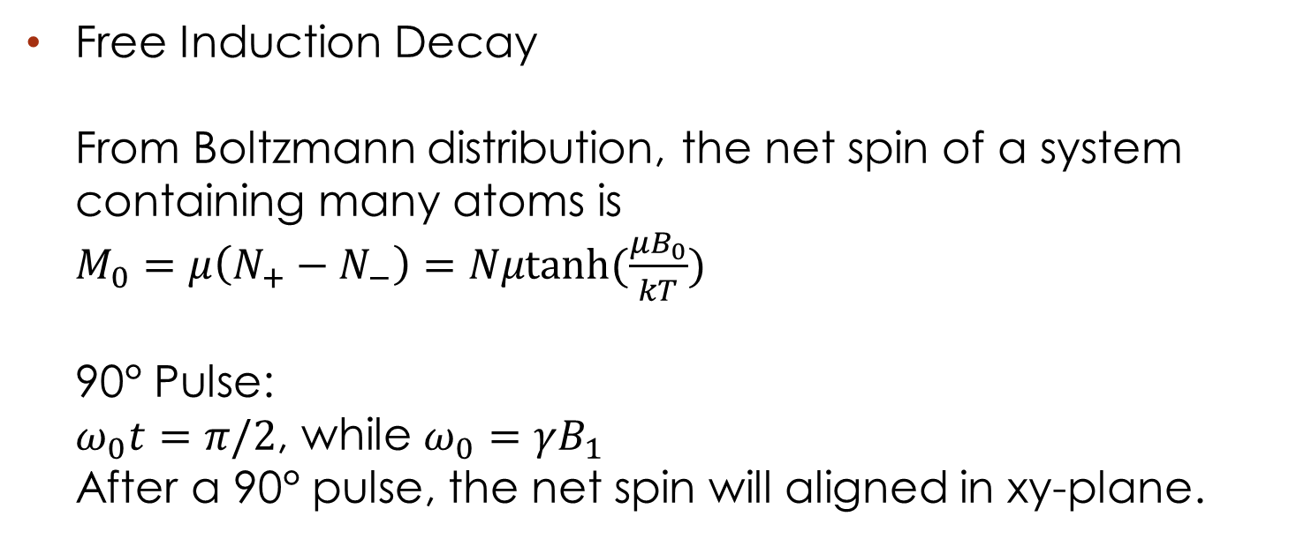
Techniques Used for NMR Spectroscopy
Free Induction Decay
From Boltzmann distribution, the net spin of a system containing many atoms is
$M_{0}=μ\left(N_{+}−N_{−}\right)=Nμtanh(\frac{μB_{0}}{kT})$
90° Pulse:
$ω_{0}t=π/2$, while $ω_{0}=γB_{1}$
After a 90° pulse, the net spin will aligned in xy-plane.

Slide 6
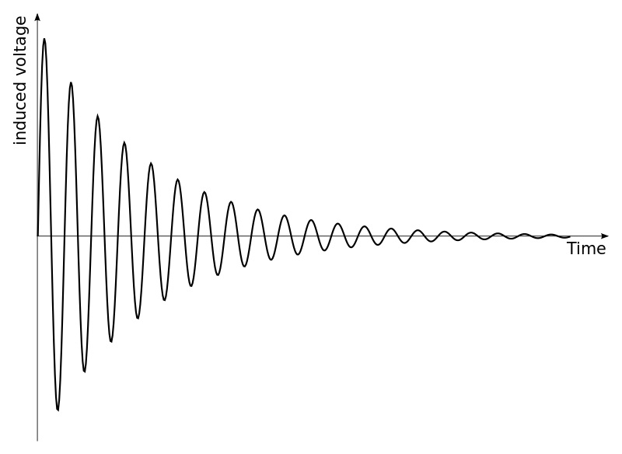
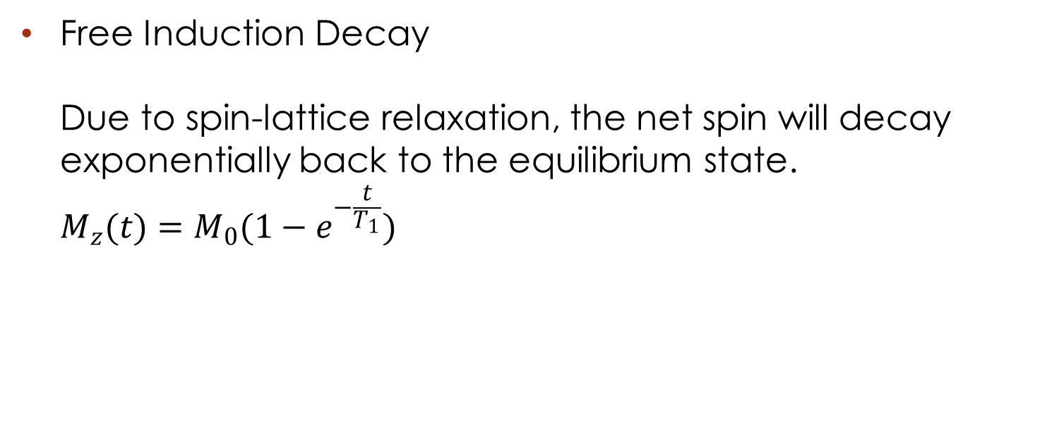
Free Induction Decay
Due to spin-lattice relaxation, the net spin will decay exponentially back to the equilibrium state.
$M_{z}(t)=M_{0}(1−e^{−\frac{t}{T_{1}}})$
http://en.wikipedia.org/wiki/Free_induction_decay

Slide 7
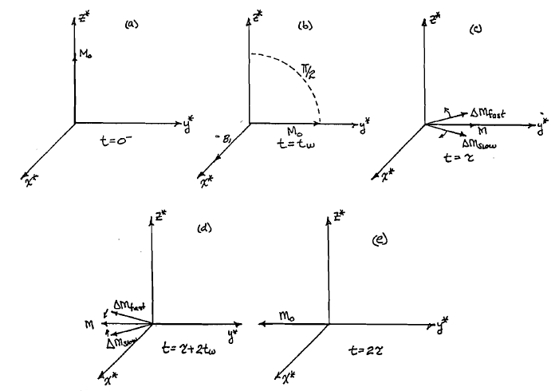

Spin-echo Measurement
After a 90° pulse, the net spin will start to dephase.
$M_{x,y}(t)=M_{0}e^{−\frac{t}{T_{2}}}$
A 180° pulse will
be added on
the system after
a period of time.
The spin will gather
again in the
opposite direction.
TeachSpin Instructional Pulsed NMR Apparatus Instruction Manual

Slide 8
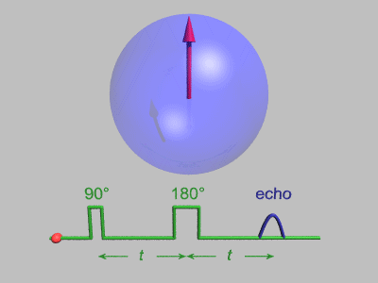
http://en.wikipedia.org/wiki/Spin_echo

Slide 9
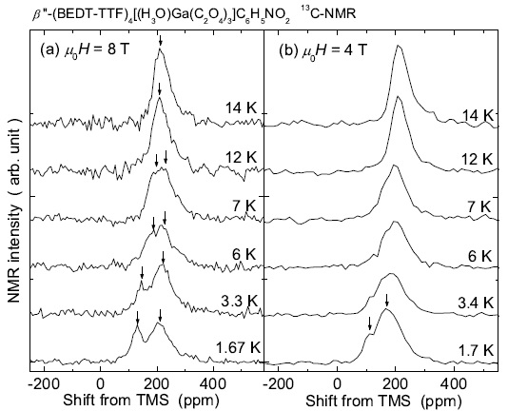
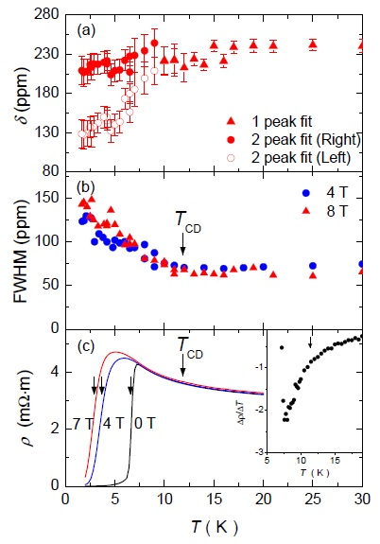
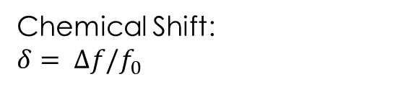
Recent Discovery
13C NMR Study in β$′′$-(BEDT-TFF)₄[(H₃O)Ga(C₂O₄)₃]•C₆H₅NO₂
Chemical Shift:
$$δ= ∆f/f_{0}$$

Slide 10
THANK YOU!

